Slide 1



SOFTWARE ENGINEERING
LAYERED TECHNOLOGY
Presented by: Anvi Borse
Roll no. : 21102A0010

Slide 2


SOFTWARE ENGINEERING LAYERS
Software Engineering is a layered technology. It is the application of principles used in the field of engineering, which usually deals with physical systems, to the design, development, testing, deployment and management of systems. The main objective of software engineering layers is to help software developers obtain high-quality software.

Slide 3
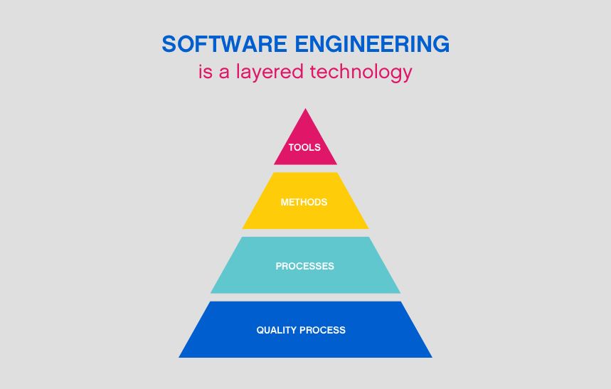


Slide 4

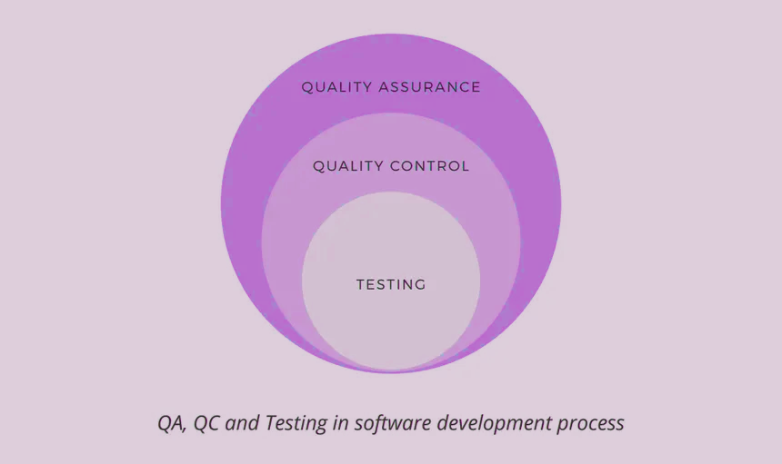


QUALITY FOCUS
Software engineering must rest on an organizational commitment to quality. Total quality management and similar philosophies foster a continuous process improvement culture, and this culture ultimately leads to the development of increasingly more mature approaches to software engineering. The bedrock that supports software engineering is a quality focus.

Slide 5

PROCESS
The foundation for software engineering is the process layer. Process defines a framework for a set of Key Process Areas. that must be established for effective delivery of software engineering technology. Consequently, this establishes the context in which technical methods are applied, work products such as models, documents, data, reports, forms, etc. are produced, milestones are established, quality is ensured, and change is properly managed.

Slide 6
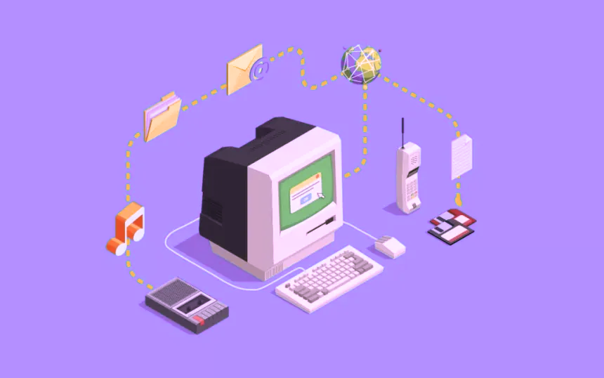
METHODS
Software Engineering methods provide the technical “how to’s for building software“. Methods encompass a broad array of tasks that include communication, requirements analysis, design modelling, program construction, testing and support.

Slide 7
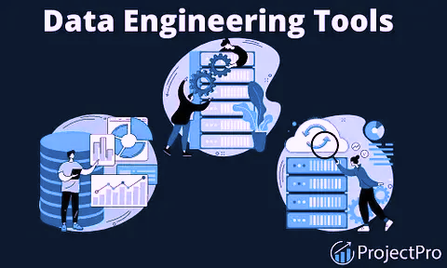
TOOLS
The involves choosing the semi-automated and automated tools thatwill become the framework for the project. Some examples mayinclude:o Choosing Microsoft Publisher for web designo Using Selenium for testing across platformso Using an integrated development environment (IDE) for buildingapps• Software engineering tools provide a self-operating system forprocesses and methods. Tools are integrated which meansinformation created by one tool can be used by another

Slide 8



BENEFITS
Improved Scalability and Maintainability
Layered technology allows for changes to be made to specific layers of the software without affecting the entire system. This improves scalability and makes maintenance easier.
Clear Separation of Concerns
Each layer has a specific function and set of responsibilities. This makes it easier for developers to understand and modify specific parts of the software.
Increased Reusability and Modularity
Layered technology promotes code reuse and modularity. Modules can be easily swapped out or used in different projects with minimal changes required.

Slide 9
CHALLENGES AND CONSIDERATIONS
COMPLEXITY AND LEARNING CURVE
COMMUNICATION AND COORDINATION BETWEEN LAYERS
OVER-ENGINEERING
Layered technology can increase complexity and require a steeper learning curve for developers.
Effective communication and coordination is necessary between layers to ensure that data is handled properly and there are no conflicts.
There is a risk of over-engineering the software, leading to unnecessary layers and complexity.

Slide 10
THANK YOU

